Slide 1
Developing text-to-speech and speech-to-text systems using regular expressions
ASHIMA FATIMA SEIK MUGIBUR RAGHMAN
21BAI1830
Notes:
Hello and welcome to this video presentation on developing text-to-speech or speech-to-text systems using regular expressions and finite state automata.

Slide 2
01
Regular Expressions
Used to recognize patterns within a spoken language
Notes:
So, let's start with regular expressions. Regular expressions are a powerful tool for analyzing and manipulating text data. For example, we can use a regular expression to search for all occurrences of a specific word within a text document.
In the context of text-to-speech or speech-to-text systems, regular expressions can be used to recognize patterns within spoken language.
In order to explain the way this is done, let me first explain some background knowledge in linguistics.

Slide 3
Phonemes
Do changes in sound = changes in meaning of a word?
The study of patterns and variations of sounds is known as phonology.
Phonemes are the smallest unit of sound that can change the meaning of a word in that language
/a/ for a
In English:
/p/ and /b/ are distinct phonemes
E.g. bat vs pat – the meaning of the word is changed
But a single phoneme /t/ is not differentiated
E.g. water in British and American English
woh-tuh and wah-ter (pay attention to the latter half of the word)
The sounds are different to hear but the meaning is the same
Notes:
In a particular language, a single word may be pronounced with different sounds in different accents and yet still hold the same meaning. In another language, this change of sound in a word can be significant and can lead to entire different meanings.
Specifically, phonemes are abstract units of sound that represent the basic building blocks of a language's sound system. Meaning, they are the smallest unit of sound that can change the meaning of a word in that language.
Phonemes are represented with the letter in the middle of slashes like this: /t/
Here is an example to better understand this.

Slide 4
How do this relate to us?
Phonemes provide a basis for representing sounds of a language in a way that is independent of the way a particular speaker speaks or recording conditions.
By synthesizing the appropriate phonemes, a text-to-speech system can produce a spoken output that accurately represents the text input.
Notes:
Phonemes are important in the fields of speech recognition and synthesis because they provide a basis for representing the sounds of a language in a way that is independent of the particular speaker or recording conditions.
And this allows us to use regular expressions to recognize specific phonemes or groups of phonemes within a spoken word and allows us to break down a spoken word into its component parts and analyze it using an algorithm.

Slide 5
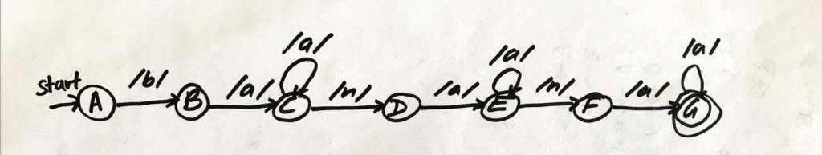
Finite State Automata
An FSA can be used to recognize a sequence of phonemes and generate a corresponding sequence of written words, or vice versa
Let’s look at the FSA to recognize the spoken word ‘banana’
This FSA can recognize the word "banana" in several different pronunciations, such as "buh-nan-uh", "buh-nah-nuh", or "buh-nan-nuh".
Notes:
So, Finite state automata, or FSAs, in the context of spoken language, can be used to recognize a sequence of phonemes and generate a corresponding sequence of written words, or vice versa.
Let's take a look at an example of an FSA that recognizes the word "banana":

Slide 6
Finite State Transducers
Regular expressions and FSAs are limited when it comes to recognizing and generating complex sequences of symbols.
Finite state transducers or FST, is a type of FSA that not only recognizes patterns in a sequence of symbols, but also maps these patterns to a new sequence of symbols.
An FST is defined as a 7-tuple (Q,Σ,Γ,δ,ω,q0,F), where:
Q is a finite set of states
Σ is a finite set of input symbols
Γ is a finite set of output symbols
δ is the transition function
ω is the output function
q0 is the start state
F is the set of final states
Notes:
[Part 4: Finite State Transducers]
Now while, finite state automata and regular expressions are useful for recognizing patterns in text and speech, the capabilities of these models are limited when it comes to recognizing and generating complex sequences of symbols. This is where finite state transducers or FSTs come in.
An FST is a type of FSA that not only recognizes patterns in a sequence of symbols, but also maps these patterns to a new sequence of symbols. In the context of speech recognition and synthesis, an FST can be used to recognize a sequence of phonemes and generate a corresponding sequence of written words, or vice versa.
Formally, an FST is defined as a 7-tuple where

Slide 7
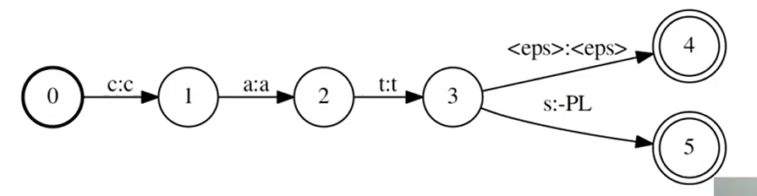
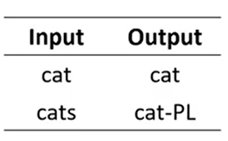
FST
The main difference between an FSA and a transducer is that transducers also have outputs.
Notes:
So, here’s an example that outputs the word or sound cat

Slide 8
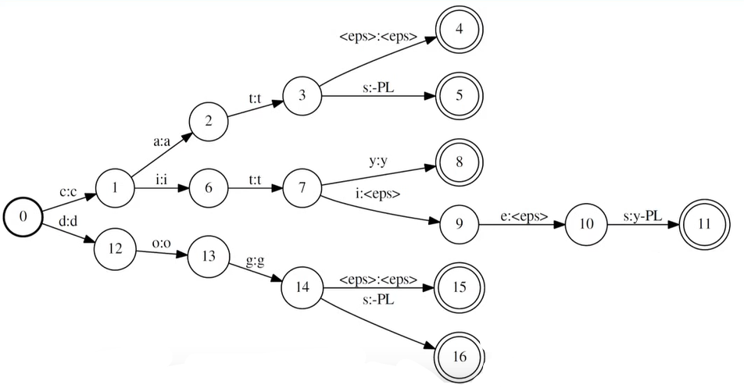
cat(s), dog(s), city(ies)

Slide 9
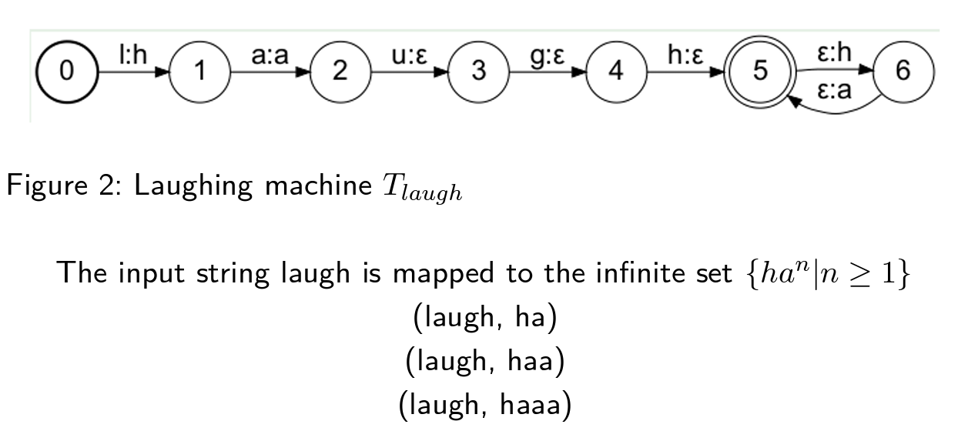
In another example, if the FST recognizes the sequence of phonemes /w/ /ah/ /n/, it will generate the written digit "1". If it recognizes the sequence /t/ /uw/ /u/, it will generate the written digit "2". And so on, for all ten digits.
Notes:
that recognizes spoken digits and generates the corresponding written digits

Slide 10
Limitations of FSTs
Only able to recognize and generate sequences of symbols that are predictable and have a clear structure.
For example, an FST might have trouble recognizing informal speech or speech with a heavy accent.
Not able to handle context-sensitive patterns or patterns that require more advanced linguistic knowledge.
For example, an FST might have trouble recognizing idiomatic expressions or recognizing words that are similar in sound but have different meanings (i.e. homomorphisms)
lie and lye
read and red
Notes:
While FSTs are powerful tools for speech recognition and synthesis, they do have their limitations. One limitation is that they are only able to recognize and generate sequences of symbols that are predictable and have a clear structure. For example, an FST might have trouble recognizing informal speech or speech with a heavy accent.
Another limitation is that FSTs are not able to handle context-sensitive patterns or patterns that require more advanced linguistic knowledge. For example, an FST might have trouble recognizing idiomatic expressions or recognizing words that are similar in sound but have different meanings.

Slide 11
Weighted Finite State Transducers
Weighted Finite State Transducers (WFSTs) are FSTs that are capable of handling probabilistic and context-sensitive patterns.
In Natural Language Processing (NPL), a collection of text or audio is organized into a dataset called a corpus.
We can use a corpus to improve the accuracy of speech synthesis as it provided key data about the frequency of occurrence of a given sound or a given word.
In a WFST, each transition is assigned a weight that represents the probability of that transition occurring.
This allows the WFST to model patterns that are not strictly predictable, such as speech with a heavy accent or informal speech.
Notes:
To overcome the limitations of basic FSTs, researchers have developed the WFST

Slide 12
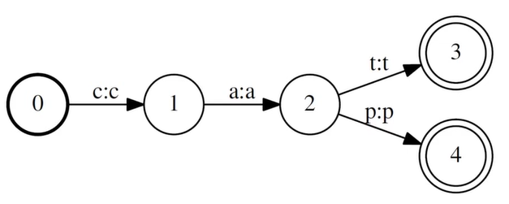
Let’s say we have the FST below, which accepts the strings {cat, cap}
How would you describe the corpus {cat, cat, cat, cap}?

Slide 13
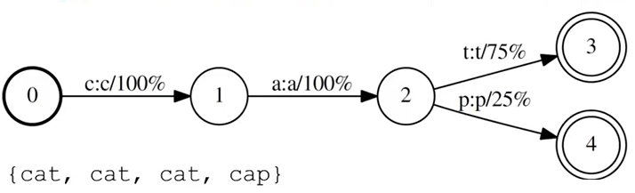

Slide 14
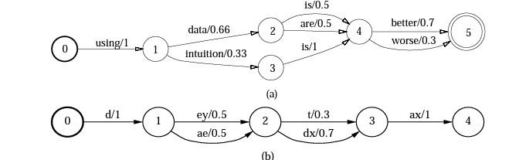

Slide 15
Even more accuracy?
Neural Networks can learn to recognize and generate speech and language by training on large amounts of data and are particularly useful for recognizing complex patterns, such as natural language.
In a neural network, the input is fed into a layer of interconnected nodes called neurons. Each neuron applies a mathematical function to its inputs and produces an output, which is then fed into the next layer of neurons. The output of the final layer is the output of the neural network which is significantly more accurate than the WFST technique due to the larger amount of data processed within
Notes:
Another technique is the use of neural networks, which can learn to recognize and generate speech and language by training on large amounts of data. Neural networks are particularly useful for recognizing complex patterns, such as natural language.
In a neural network, the input is fed into a layer of interconnected nodes called neurons. Each neuron applies a mathematical function to its inputs and produces an output, which is then fed into the next layer of neurons. The output of the final layer is the output of the neural network.

Slide 16
07
Conclusion
Regular expression, FSA, FST, WFST, Neural networks
Notes:
In conclusion, finite state transducers are a powerful tool for speech recognition and synthesis, language translation, and more. While they have their limitations, advanced techniques such as weighted finite state transducers and neural networks can help overcome these limitations and enable more accurate and flexible speech and language models.
Thank you for watching this presentation, and I hope you found it informative

Slide 17
Thanks!
https://youtu.be/YjCYtl6yshI

